Slide 1
AutoConnect Smart Vehicle Service Center Locator
Guided by: Ms. Sreelekshmi K S Presented by: P Niranjan Assistant Professor S3 MCA Department of Computer Application Roll No: 38

Slide 2
Contents
Introduction
Abstract
Scope & Objective
Feasibility Study
Existing System
Proposed System
Literature Review
System Specifications
Modules of Proposed System
Diagrams : ER, DFD, Use Case Diagram, Class Diagram, Sequence Diagram, System Architecture
Result Analysis
Conclusion
Future Scope
References

Slide 3
Introduction
This project focuses on developing a Service Center Management System that connects users, and service centers through a structured digital platform.
The system allows users to alert for emergency,book services, rate and review service centers, while service centers can manage bookings and monitor feedback of users.
By integrating booking, review, and management features, the project aims to improve efficiency, transparency, and customer satisfaction in service operations.

Slide 4
Abstract
Vehicle breakdowns or scheduled maintenance may require users to manually search for a reliable service center.
To address this issue, this project is aimed at simplifying the process of locating nearby vehicle service centers.
The system allows Users to view available service centers, book appointments, and track service progress. Service providers, on the other hand, can register their workshops, manage service listings, update availability, and respond to bookings
The application bridges the gap between vehicle owners and service providers, offering transparency, and time-saving functionalities.

Slide 5
Scope
User Accessibility & Convenience
Online Booking & Scheduling
Service History Tracking
Service Provider Interface
Ratings & Feedback System
Admin Panel

Slide 6
Objective
To develop a user-friendly platform.
To enable online appointment booking.
To provide real-time visibility of service center details.
Bridges the gap between vehicle owners and service providers.
A dedicated interface for service providers.
To maintain service history logs for users.
To improve transparency and trust.

Slide 7
Feasibility Study
Technical Feasibility : Developed using Python Django for backend, HTML/CSS for frontend
Operational Feasibility : Fulfills a real need for both vehicle owners and service providers
Economic Feasibility : Development can be done with free/open-source tools
Legal and Ethical Feasibility : Complies with standard data protection practices
Schedule Feasibility : Estimated development time: 8–12 weeks.

Slide 8
Problem Definition
Vehicle breakdowns or scheduled maintenance may require users to manually search for a reliable service center.
This manual searching will be time-consuming and also it is inefficient.
To address this issue, This project aimed at simplifying the process of locating nearby vehicle service centers and managing service bookings.

Slide 9
EXISTING SYSTEM
🟢 Pros:
Local familiarity.
No internet dependency.
Flexibility in Service
🔴 Cons:
Lack of Accessibility
No Real-Time Availability or Booking
No Service Comparison
Inefficient Communication
Lack of Emergency Support

Slide 10
PROPOSED SYSTEM
🟢 Pros:
Real-Time Information
Online Booking and Scheduling
Service Center Listings with Reviews
User-Friendly Interface
Emergency Support Access
Centralized Service History
🔴 Cons:
Internet Dependency
Limited Digital Literacy
Cost of Development and Hosting

Slide 11
Literature Review
AUTHOR | YEAR | SOURCE | TITLE | WORK
Swarali Degaonkar, Manasi Khillare, Dr. Aarti Agarkar | 2023 | IJARIIT | Vehicle Service Automation | Allows to search and communicate for nearby service centers using user’s current location.
Sathwik Krishna L, Siva Rama Krishna S. | 2021 | IJSRCSEIT | Vehicle Breakdown Service Provider System | Web-based application that connects users to nearby mechanics in case of breakdown.
M. A. R. Kumar, K. N. Rama Krishna. | 2022 | i‑manager’s Journal | Automatic Car Service Recommendation System | Uses machine learning to automatically detect car damage.
Dinesh S. Bhadane, Pritam B. Bharati. | 2023 | ResearchGate | Review on GSM and GPS Based Vehicle Tracking System | Survey of vehicle tracking technologies including GSM modules and GPS integration
Dr. Raghu R, Dr. Mala K. M.. | 2023 | IJARIIT | Integration of GPS in Emergency Service Vehicles | Focused on using GPS to dynamically control traffic lights to prioritize ambulances and emergency vehicles.

Slide 12
System Specifications
Processor: Intel i3 or above (or equivalent AMD)
RAM: Minimum 4 GB (8 GB recommended)
Memory: 500 MB or above
Operating System: Windows / Linux / macOS
Internet: A stable internet connection
Browser: Any kind of internet browsers

Slide 13
Modules of Proposed System
User Management Module
Service Center Management Module
Booking & Scheduling Module
Review & Rating Module
Admin Module

Slide 14
ER Diagram

Slide 15
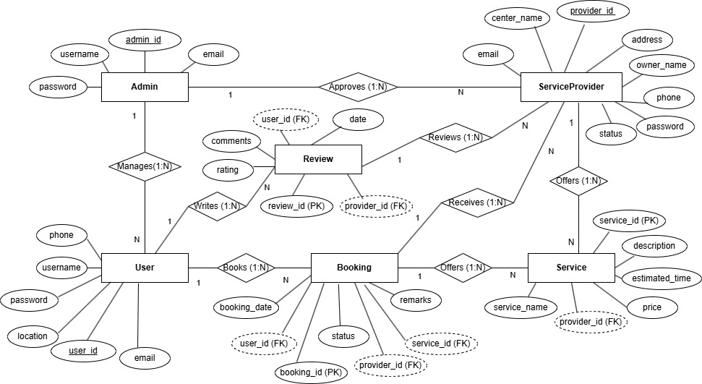

Slide 16
Data Flow Diagram

Slide 17
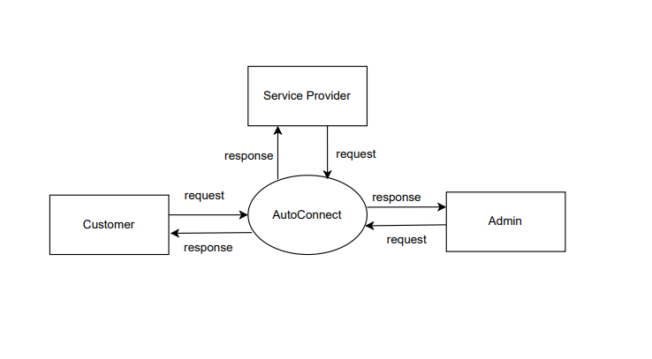
LEVEL 0

Slide 18
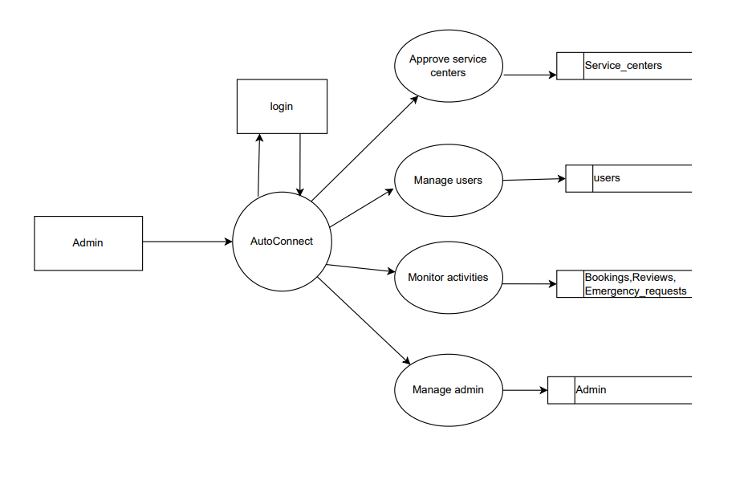
LEVEL 1
ADMIN

Slide 19
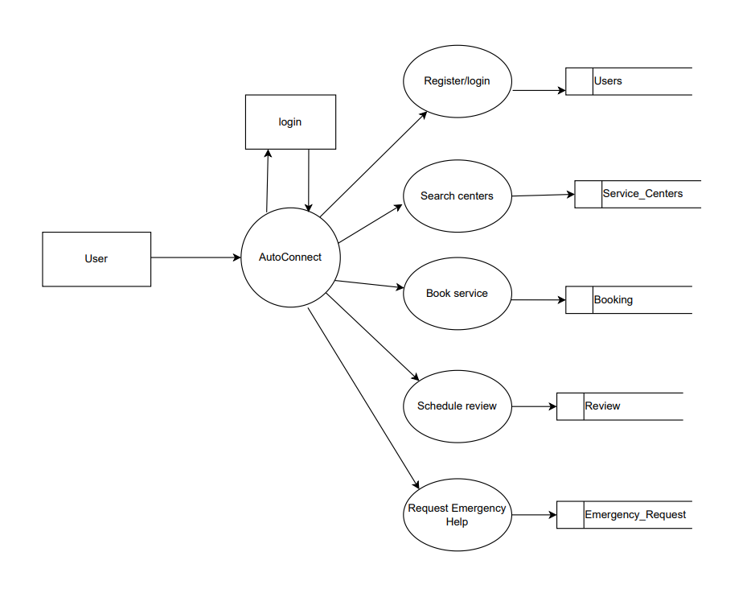
LEVEL 1 USER

Slide 20
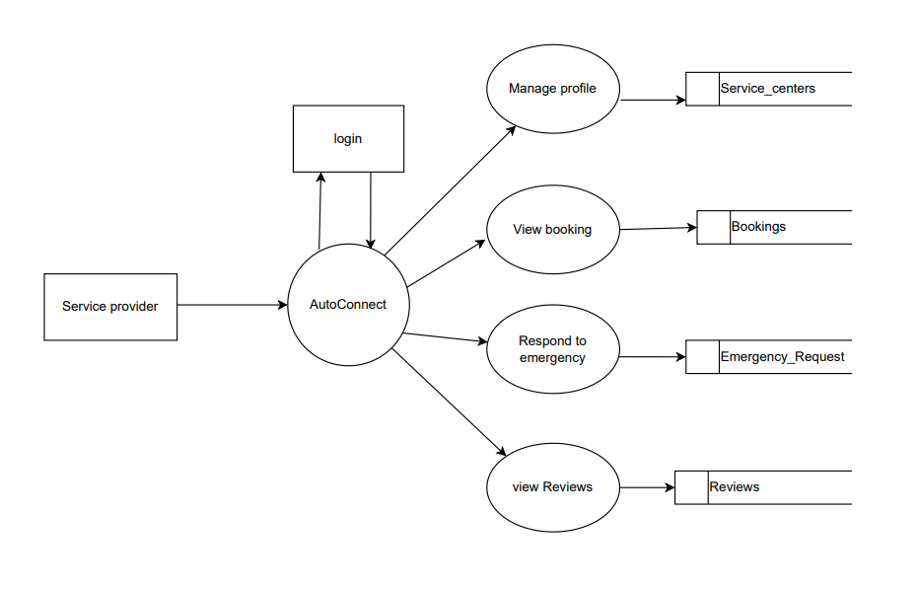
LEVEL 1 SERVICE PROVIDER

Slide 21
Use Case Diagram

Slide 22
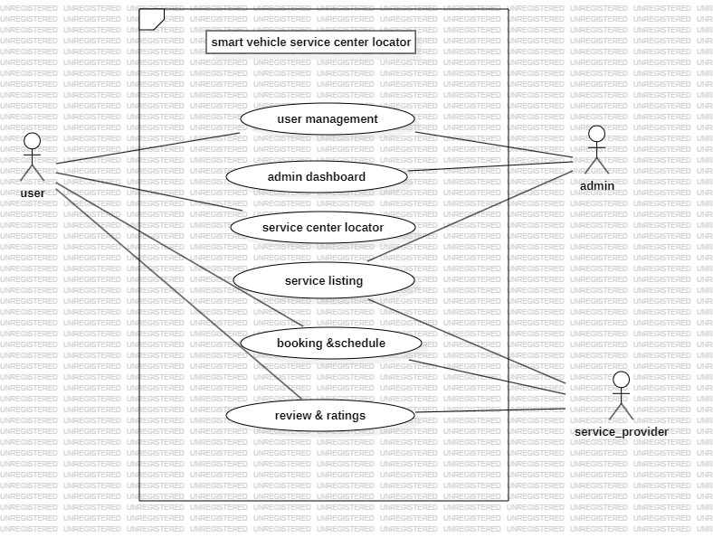

Slide 23
Class Diagram

Slide 24
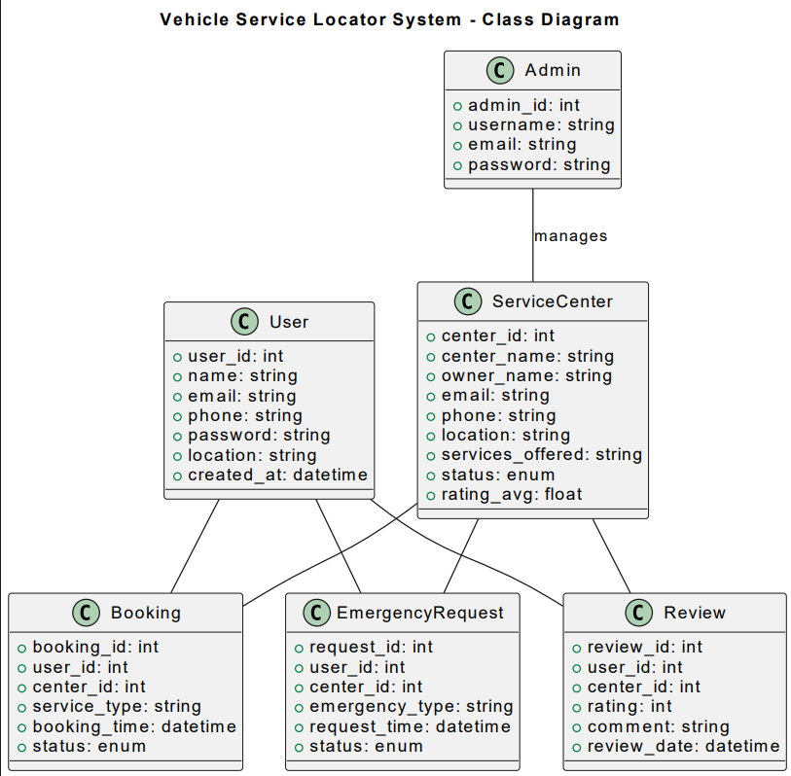

Slide 25
Sequence Diagram

Slide 26
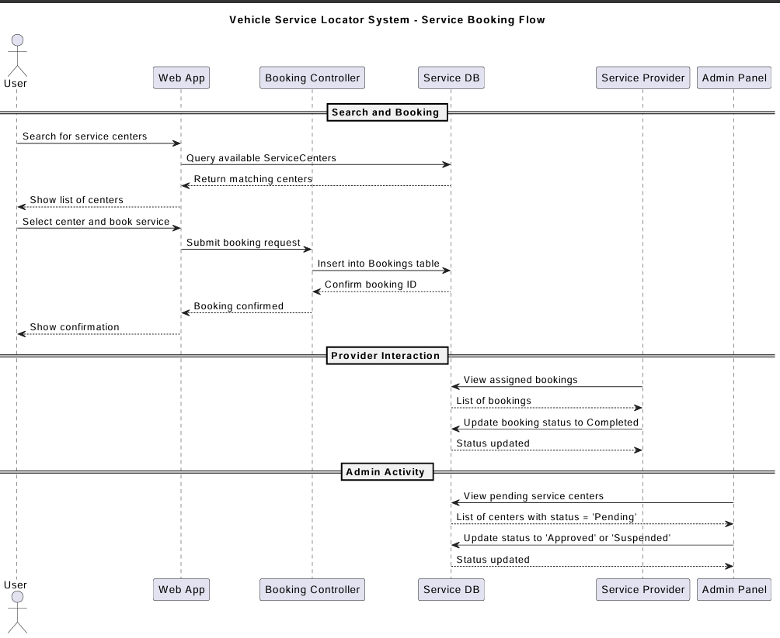

Slide 27
System Architecture

Slide 28
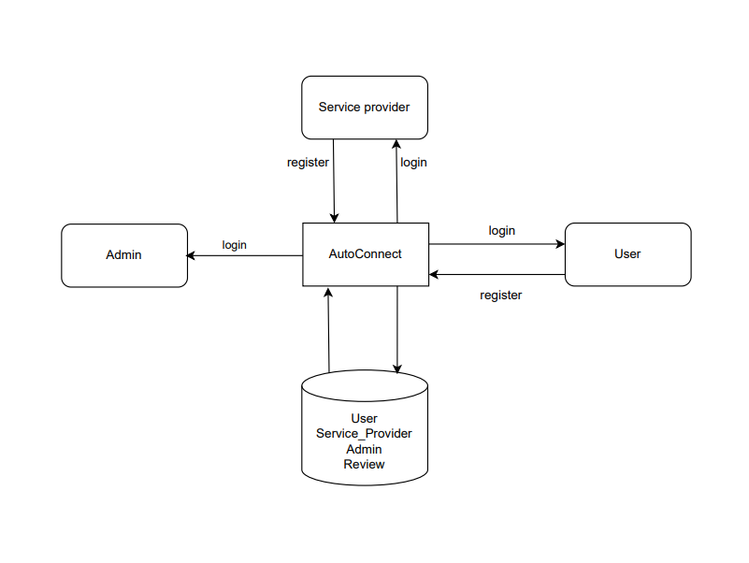

Slide 29
Result Analysis
Allows users to easily find and book services from nearby approved service centers.
Response time for emergency and regular service requests is reduced compared to manual booking.
Review and Rating feature helps users choose better service centers and improves transparency.
Service providers can manage bookings, customers, and services more efficiently using their dashboard.
Works smoothly with multiple users and can be expanded with more features in the future.

Slide 30
Conclusion
The project successfully bridges the gap between users and service providers through a unified digital platform.
Simplifies booking, tracking, and managing vehicle services efficiently.
Admin approval ensures authenticity and reliability of registered service providers.
Improves transparency, communication, and overall user satisfaction.
Demonstrates effective use of web technologies for real-world problem solving.
With future enhancements, the platform can evolve into a complete vehicle service management ecosystem

Slide 31
Future Scope
Mobile Application: Develop a dedicated Android and iOS app for easier access and notifications
Online Payment Integration: Add secure UPI/card payment options for booking and billing.
Live Tracking: Enable real-time tracking of service personnel or repair status.
AI-Based Service Recommendations: Suggest best service centers based on user location and reviews.
Chat Support: Integrate real-time chat between users and service providers for faster communication.
Automated Feedback System: Use analytics to automatically evaluate and rank service centers.

Slide 32
References
Laxman Krishnan, Arathy S.(2021). GPS-Based Emergency Vehicle Detection System. IJARIIT. https://www.ijariit.com/manuscript/gevas-gps-based-emergency-vehicle-detection-system
Sathwik Krishna L, Siva Rama Krishna S.(2021). Vehicle Breakdown Service Provider System. IJSRCSEIT. https://ijsrtcse.com/Special-Issue/2021/July/17.pdf
Dinesh S. Bhadane, Pritam B. Bharati.(2023). GSM and GPS Based Vehicle Tracking System. ResearchGate. https://www.researchgate.net/publication/373058857_Bubble_rupture_viability_of_red_blood_cells_under_resonant_acoustic_standing_waves
Dr. Raghu R., Dr. Mala K. M.(2023). Integration of GPS in Emergency Service Vehicles. IJARIIT. https://www.ijariit.com/manuscript/a-study-on-the-integration-of-gps-in-emergency-service-vehicles/

Slide 33
Thank You!

